Slide 1
Urinary Tract Infection (UTI) Prepared By: Shawn Glassman
Women’s Health/Molecular/Infectious Disease

Slide 2
What is a UTI?
UTI Symptoms
A strong, persistent urge to urinate
A burning sensation when urinating
Passing frequent, small amount of urine
Urine appears cloudy
Urine that appears red, bright pink or cola-colored-a sign of blood in the urine
Strong-smelling urine
Pelvic pain, in women-especially in the center of the pelvis and around the area of the pubic bone
UTIs maybe overlooked or mistaken for other conditions in older adults.
https://www.mayoclinic.org/diseae-conditions/urinary-tract infections/symptoms-causes/syc-20353447
A urinary tract infection (UTI) is an infection in any part of your urinary system. Your kidneys, ureters, bladder and urethra. Most infections involve the lower urinary tract- the bladder and the urethra.
Women are at greater risk of developing a UTI than men. Infection limited to your bladder can be painful and annoying. However, serious consequences can occur if a UTI spreads to your kidneys.
Doctors typically treat UTIs with antibiotics. But you can take steps to reduce your chances getting a UTI in the first place.
https://www.mayoclinic.org/diseae-conditions/urinary-tract infections/symptoms-causes/syc-20353447

Slide 3
UTI Complications
When treated promptly and properly, lower urinary tract infections rarely lead to complications. But left untreated, a urinary tract infection can have serious consequences.
Complications of a UTI may include:
Recurrent infections, especially in women who experiencetwo or more UTIs in a six-month period or four or more within a year.
Permanent kidney damage from an acute or chronic kidney infection (pyelonephritis) due to an untreated UTI.
Increased risk in pregnant women of delivering low birth weight or premature infants.
Urethral narrowing (stricture) in men from recurrent urethritis, previously seen with gonococcal urethritis
Sepis, a potentially life-threatening complication of an infection, especially if the infection works its way up to your urinary tract to your kidneys.
https://www.mayoclinic.org/diseae-conditions/urinary-tract infections/symptoms-causes/syc-20353447

Slide 4
Sanford Guide- Medication Recommendations
Since 1969, Sanford Guide has been a leader in point-of-care recommendations for the treatment of infectious diseases.
Widely used by pharmacists, physicians, physician assistants, and nurses. Sanford Guide improves patient care by providing carefully curated recommendations based on the latest evidence.
Facts About Sanford Guide:
Family owned and operated
First published in 1969
>25 million aggregate circulation
Used in over 100 countries and in multiple languages
Relied upon by over 4,000 facilities
9-member editorial board from leading clinical and academic institutions
https://www.sanfordguide.com/about/fast-facts/

Slide 5
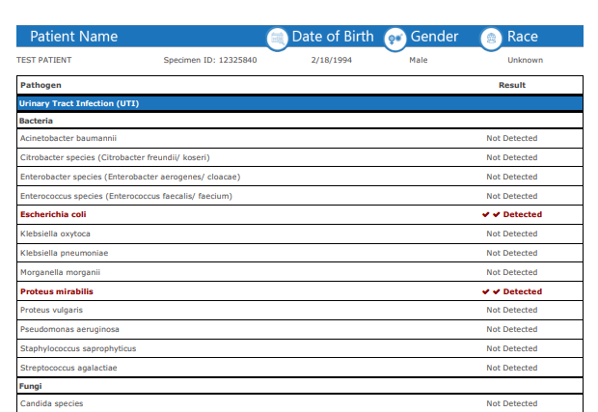
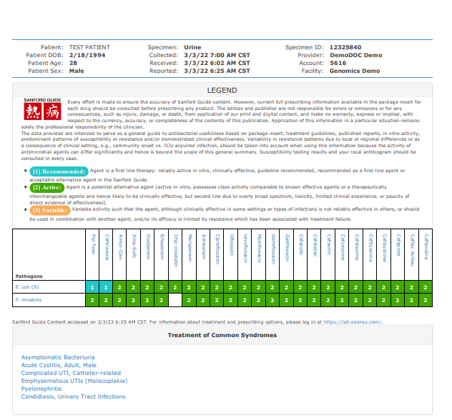

Slide 6
Antibiotic Resistance (ABR)-PCR
2 ABR offerings: determined by clinical utility
These are the only two ABR genes for UTI with specific CPT codes, 87500 and 87641 due to the extensive clinical correlation between the ABR and the AST correlation.
Removes the guesswork from providers
Staphylococcus aureus w/ reflex to mecA (Methicillin)
Enterococcus faecalis w/ reflex to vanA1/A2/B (Vancomycin)
Enterococcus faecium w/ reflex to canA1/A2/B (Vancomycin)
Note: If any one of these 3 pathogens are detected, testing will automatically reflex to the ABR
Note: If any pathogen is detected, testing will automatically reflex to AST- Antimicrobial Susceptibility Testing

Slide 7
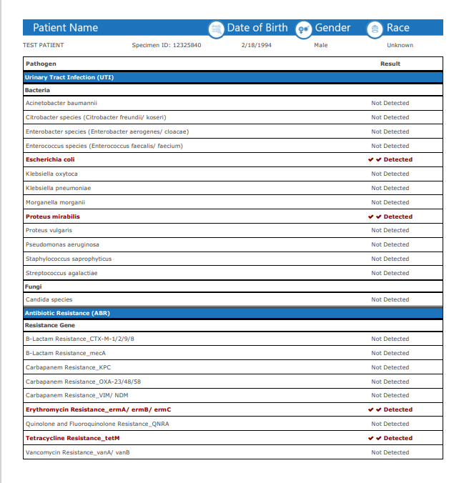
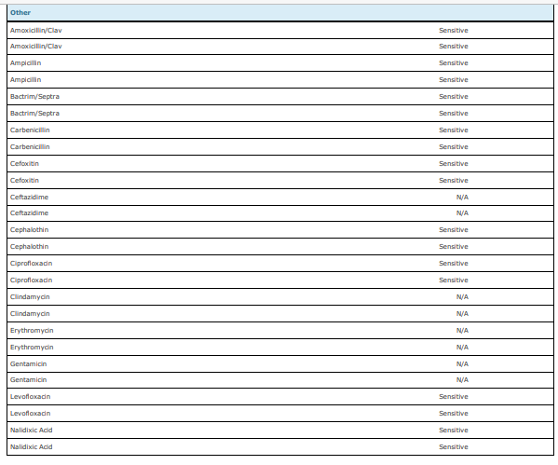

Slide 8
Polymerase Chain Reaction- PCR

Slide 9
Components of PCR
Polymerase- Enzymes that can assemble new strands of DNA from template DNA
Template DNA: The DNA that your polymerase will read and copy
Primers- Forward and Reverse primers
Nucleotides- Monomers of DNA. These are necessary for making DNA copies
Buffer- Supply the correct pH and additives like magnesium, potassium, or DMSO
Thermocycling
Thermocycling is where the magic happens. All of the above components are combined to a PCR tube and thermocycled. This is completed by rapidly heating and cooling the mixture in a precise manner.

Slide 10
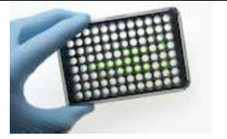
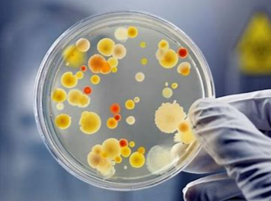
UTI- PCR vs Traditional Culture
Molecular (targeted Testing Approach)
Patient sample aliquoted into processing plate
Highly sensitive and specific. Very Fast
PCR-Polymerase Chain Reaction
A biochemical technique using thermocycling and enzymes to quickly and reliably copy DNA
Traditional Culture (Growth Testing Approach )
Patient sample streaked onto microbiology dish
Dominant bacterium growth. Very Slow
Incubation, slow growth of all pathogens
Identification of dominant pathogens via microscopy

Slide 11
Antibiotic Resistance- Molecular vs Microbiology
Molecular (targeted Testing Approach)
Patient sample aliquoted into processing plate
Highly sensitive and specific. Very Fast
Patient Specific Only
Inverse of Sensitivity
Traditional AST (Growth Testing Approach )
Cultured sample streaked onto microbiology dish
Cultured sample is treated with specific antibiotics
Pathogens “show” resistance to antibiotics (non-binding)
Provides result that is Patient, Pathogen, and Antibiotic, specific

Slide 12
ABR vs Sensitivity
ABR: Antibiotic Resistance
Inverse of sensitivity: Which antibiotics will potentially not work with the specific patient sample
PROs- Very Fast
CONs- Can contradict AST causing confusion with providers
Sensitivity
Which antibiotics will work best to treat the illness of infection discovered in the culture
PROs- Accuracy and The Gold Standard
CONs- Slow

Slide 13
Reporting
Prelim Report within 30 hours of the sample received at the lab
Pathogen Detection
Medication Recommendations
ABR
Final Report within 48 hrs of the sample received at the lab
All of the above
ABR

Slide 14
Antibiotic Stewardship CDC ABR Threats https://www.cdc.gov/drugresistance/biggest-threats.htm

Slide 15
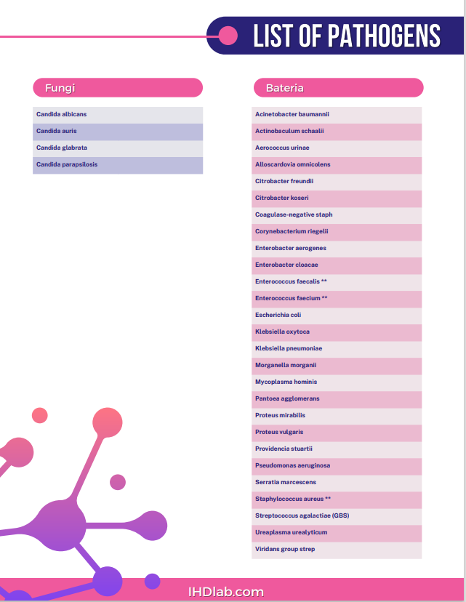
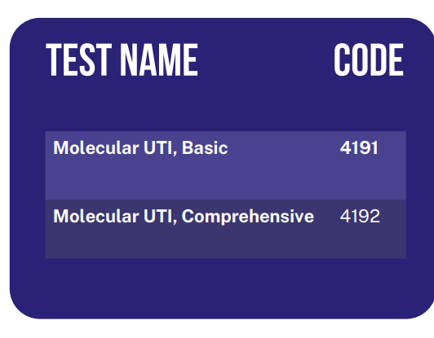
Urinary Tract Infection Offering- PCR

Slide 16
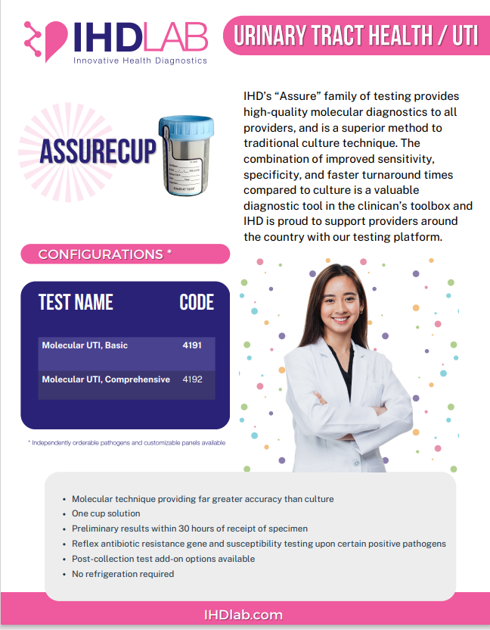
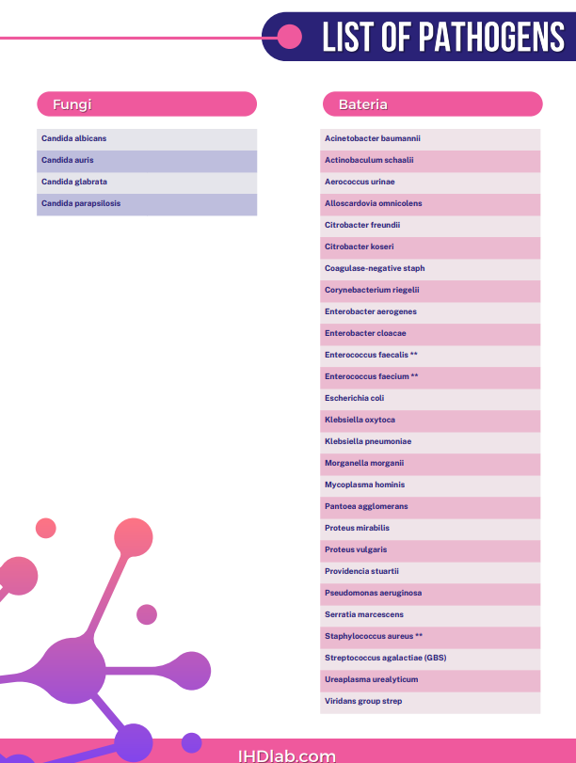
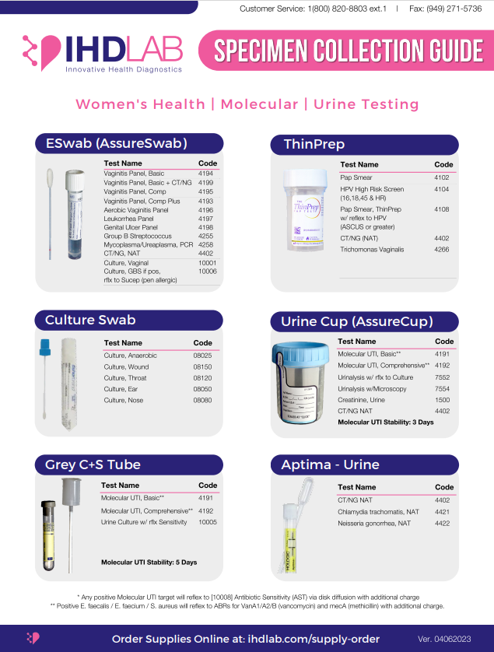
UTI Marketing Material

Slide 17
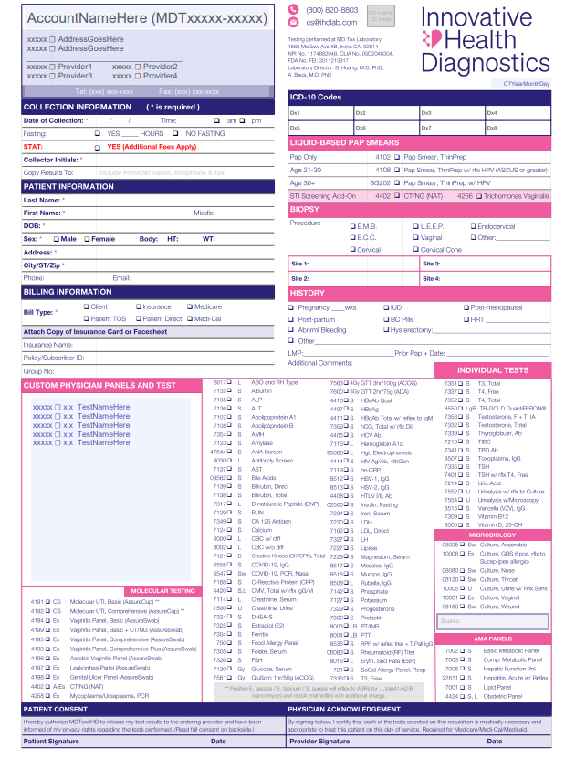
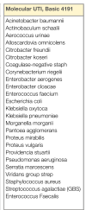
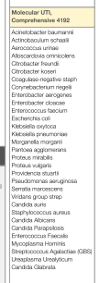
Fully Loaded Requisition Molecular Testing

Slide 18
Billing/Coverage- CMS LCD
Urinary Tract Infection (UTI)- Testing will be covered according to the following criteria: The patient is symptomatic And at higher risk for UTI complications (ie: patients with recurrent symptomatic UTIs and/or complicated urinary tract anatomy) OR is seen in urogynecology or urology specialty care setting.
https//www.cms.gov/medicare-coverage-database/details/lcd-details.aspx?LCDid=39000&Contrid=364
In August 2022, Medicare set new criteria for billing. This affects Medicare patients only. Laboratories must bill with a Z code and be affiliated with Mold DX/Palmetto in order to be reimbursed for Medicare patients.
Private Insurance payors are reimbursing for molecular UTI testing
Deductibles and coinsurance are patients' responsibility.

Slide 19
Call Points/Questions
Initial Focus- Phase 1
OBGYNs
GYNs
Urogynecologists
For now, please do not call on Urologists, Urgent Cares, Long-Term Care or SNF facilities. Heavy Medicare population. IHD is working on a solution to remedy the Mold DX/Palmetto issue. This will be phase 2 of IHDs marketing initiative.
Leverage the medication recommendations, and ABR results within 30 hours of sample received. Providers can treat patients sooner than later. IHD is bridging the gap between diagnostics and therapeutics.
ASK PROBING QUESTIONS:
How often does the provider receive a negative urine culture result on a symptomatic patient?
Does your current lab offer medication recommendations, ABR and AST results on report?
What is the TAT for a urine culture?
How many patients do you see with UTI infections?
Please ask office manager, back office leads the breakdown of payor mix. IHD would like to keep the Medicare volume low, less than 5%.

Slide 20
Competitive Intelligence
HealthTrackRX, QDX, Prognostics, NxGen, Vikor, MDL
Large panels with ABR ( Pathogens (30+) ABR genes (30+ genes)
TAT 24-72hrs
Billing 2-3 times Medicare; Very Expensive ($130-$150 per pathogen and ABR)
May not be contracted with all PPO plans
Outside Southern California, may have Z codes, affiliation with Mold Dx/Palmetto-Able to bill Medicare
National Sales Force- all over the country
Paper Requisitions and Electronic ordering via EMRs, portals
May offer low discount fees for unisured patients (cash price)

Slide 21
Favorite Quote
Talent wins games, but teamwork and intelligence win championships!
- Michael Jordan

Slide 22
Question and Answers

